Slide 1
Clinical Practice Guidelines
Hepatocellular carcinoma

Slide 2
About these slides
These slides give a comprehensive overview of the EASL clinical practice guidelines on the management of hepatocellular carcinoma
The guidelines were first presented at the International Liver Congress 2018 and are published in the Journal of Hepatology
A full copy of the publication can be downloaded from the Clinical Practice Guidelines section of the EASL website
Please feel free to use, adapt, and share these slides for your own personal use; however, please acknowledge EASL as the source

Slide 3
About these slides
Definitions of all abbreviations shown in these slides are provided within the slide notes
When you see a home symbol like this one: , you can click on this to return to the outline or topics pages, depending on which section you are in
Please send any feedback to: slidedeck_feedback@easloffice.eu
These slides are intended for use as an educational resource and should not be used in isolation to make patient management decisions. All information included should be verified before treating patients or using any therapies described in these materials

Slide 4
Guideline panel
Chair
Peter R Galle
Panel members
Josep M Llovet, Vincenzo Mazzaferro, Fabio Piscaglia, Jean-Luc Raoul, Peter Schirmacher, Valérie Vilgrain, Alejandro Forner (EASL Governing Board representative)
Reviewers
Tim Meyer, Gregory Gores, Jean-Franҫois Dufour
EASL CPG HCC. J Hepatol 2018; doi: 10.1016/j.jhep.2018.03.019

Slide 5
Outline
Methods
Grading evidence and recommendations
Background
Incidence of primary liver cancer
Key recommendations
Guidelines
HCC research and future goals
Trial design and endpoints
Risk factors for primary liver cancer
EASL future goals in HCC
Unmet needs in HCC
EASL CPG HCC. J Hepatol 2018; doi: 10.1016/j.jhep.2018.03.019
Notes:
HCC, hepatocellular carcinoma

Slide 6
Methods
Grading evidence and recommendations

Slide 7
Grading evidence and recommendations
Grading is a simplified adaptation of the GRADE system¹
Level of evidence* |  | Confidence in the evidence
High | Data derived from meta-analyses or systematic reviews or from (multiple) RCTs with high quality | Further research is unlikely to change our confidence in the estimate of benefit and risk
Moderate | Data derived from a single RCT or multiple non-randomized studies | Further research (if performed) is likely to have an impact on our confidence in the estimate of benefit and risk and may change the estimate
Low | Small studies, retrospective observational studies, registries | Any estimate of effect is uncertain
Grade of recommendation† (wording associated with the grade of recommendation)
Strong | “Must”, “should”, or “EASL recommends”
Weak | “Can”, “may”, or “EASL suggests”
*Level was downgraded if there was poor quality, strong bias or inconsistency between studies; level was upgraded if there was a large effect size; †Recommendations were reached by consensus of the panel and included the quality of evidence, presumed patient-important outcomes and costs
1. Guyatt GH, et al. BMJ 2008:336:924–6;
EASL CPG HCC. J Hepatol 2018; doi: 10.1016/j.jhep.2018.03.019
Notes:
GRADE, Grading of Recommendations Assessment Development and Evaluation; RCT, randomized controlled trial

Slide 8
Background
Incidence of primary liver cancer
Risk factors for primary liver cancer

Slide 9
Background
Liver cancer
Fifth most common cancer
Second most frequent cause of cancer-related death globally
854,000 new cases and 810,000 deaths per year
7% of all cancers
HCC
Accounts for approximately 90% of primary liver cancers
Constitutes a major global health problem
Akinyemiju T, et al. JAMA Oncol 2017;3:1683–91 ;
EASL CPG HCC. J Hepatol 2018; doi: 10.1016/j.jhep.2018.03.019
Notes:
HCC, hepatocellular carcinoma

Slide 10
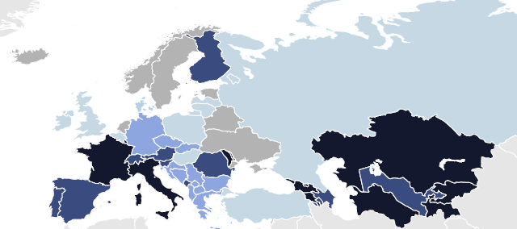
Incidence of primary liver cancer in Europe
Incidence rates per 100,000
EASL CPG HCC. J Hepatol 2018; doi: 10.1016/j.jhep.2018.03.019

Slide 11
Incidence of primary liver cancer in Europe
Incidence rates per 100,000
Total number per country
Italy 10,733 Germany 9,202 France (metropolitan) 8,332 Russian Federation 6,812 Spain 5,522 United Kingdom 4,186 Romania 2,214 Poland 1,998 Ukraine 1,567 Greece 1,054 Portugal 1,004 Austria 955 Czech Republic, 919 Switzerland 811 Serbia 799 Belgium 645 Bulgaria 640 Hungary 630 Finland 620 Sweden 490 | The Netherlands 475 Croatia 466 Republic of Moldova 448 Slovakia 398 Belarus 327 Bosnia Herzegovina 314 Denmark 311 Ireland 239 Slovenia 216 Norway 190 Lithuania 175 Albania 171 Latvia 154 FYR Macedonia 135 Luxembourg 68 Estonia 64 Cyprus 56 Montenegro 51 Malta 19 Iceland 10
EASL CPG HCC. J Hepatol 2018; doi: 10.1016/j.jhep.2018.03.019

Slide 12
Main risk factors for primary liver cancer worldwide*
~90% of HCCs are of known underlying aetiology¹
Most frequently HCV, HBV, alcohol and aflatoxin exposure
 | Alcohol (%) | HBV (%) | HCV (%) | Others (%)
Europe
Western | 32 | 13 | 44 | 10
Central | 46 | 15 | 29 | 10
Eastern | 53 | 15 | 24 | 8
North America | 37 | 9 | 31 | 23
Andean Latin America | 23 | 45 | 12 | 20
Asia
East Asia | 32 | 41 | 9 | 18
Asia-Pacific | 18 | 22 | 55 | 6
South-East Asia | 31 | 26 | 22 | 21
Africa
North Africa, Middle East | 13 | 27 | 44 | 16
Southern (sub-Saharan) | 40 | 29 | 20 | 11
Western (sub-Saharan) | 29 | 45 | 11 | 15
*Contribution of hepatitis B, C, alcohol and other causes on absolute liver cancer deaths, both sexes, globally and by region 2015. Data refer to all primary liver cancers (HCC, intrahepatic CCA and liver cancer of mixed differentiation)
1. Akinyemiju T, et al. JAMA Oncol 2017;3:1683–91;
EASL CPG HCC. J Hepatol 2018; doi: 10.1016/j.jhep.2018.03.019
Notes:
CCA, cholangiocarcinoma; HBV, hepatitis B virus; HCC, hepatocellular carcinoma; HCV, hepatitis C virus

Slide 13
Guidelines
Key recommendations

Slide 14
Topics
Epidemiology and risk factors
Prevention
Surveillance
Diagnosis
Recall policy
Staging
Treatment: liver resection
Treatment: liver transplantation
Treatment: systemic therapy
Assessment of treatment response
Palliative and best supportive care
Click on a topic to skip to that section
EASL CPG HCC. J Hepatol 2018; doi: 10.1016/j.jhep.2018.03.019

Slide 15
Epidemiology and risk factors
Incidence of HCC has been rising
Driven by increases in chronic viral infections and lifestyle-related risk factors
Cirrhosis is an important risk factor for HCC
Multiple causes, including viral hepatitis, chronic alcohol use, NAFLD
Up to 90% of HCC arises on a background of cirrhosis in the Western world¹
Recommendations
The incidence of HCC is increasing both in Europe and worldwide; it is amongst the leading causes of cancer death globally | High
Chronic liver disease should be treated to avoid progression | High | Strong
Level of evidence
Grade of recommendation
1. Forner A, et al. Lancet 2018;391:1301–1314;
EASL CPG HCC. J Hepatol 2018; doi: 10.1016/j.jhep.2018.03.019
Notes:
HCC, hepatocellular carcinoma; NAFLD, non-alcoholic fatty liver disease

Slide 16
Prevention
Primary prevention of HCC can be achieved with universal vaccination against HBV
Progression to cirrhosis and HCC can be prevented by:
Antiviral treatment in patients with chronic hepatitis B and C*
Adoption of healthy lifestyle measures
Recommendations
Vaccination against hepatitis B reduces the risk of HCC and is recommended for all newborns and high-risk groups | High | Strong
Governmental health agencies should implement policies that: Prevent HBV/HCV transmission Counteract chronic alcohol abuse Promote lifestyles that prevent obesity and metabolic syndrome | Moderate | Strong
In patients with chronic hepatitis, use antiviral therapies to: Maintain HBV suppression in chronic hepatitis B Maintain SVR in chronic hepatitis C | High | Strong
Level of evidence
Grade of recommendation
*Level of evidence high, grade of recommendation strong
EASL CPG HCC. J Hepatol 2018; doi: 10.1016/j.jhep.2018.03.019
Notes:
HBV, hepatitis B virus; HCC, hepatocellular carcinoma; HCV, hepatitis C virus; SVR, sustained virological response

Slide 17
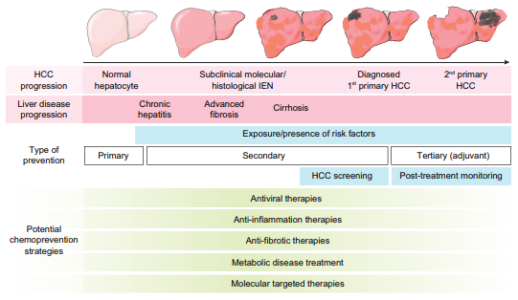
HCC preventive interventions
Fujiwara N, et al. J Hepatol 2018;68:526–49
EASL CPG HCC. J Hepatol 2018; doi: 10.1016/j.jhep.2018.03.019
Notes:
HCC, hepatocellular carcinoma; IEN, intraepithelial neoplasia

Slide 18
Role of DAAs for HCV in HCC
Effect of DAAs on HCC in patients with cirrhosis is debated
Robust conclusion impeded by retrospective assessment, absence of HCC screening, short follow-up and loss to follow-up
Recommendations
Once cirrhosis is established: Antiviral therapy* is beneficial in preventing cirrhosis progression and decompensation Successful antiviral therapy reduces but does not eliminate the risk of HCC development | Moderate
For patients with HCV-associated cirrhosis and treated HCC: HCC recurrence rate is high even after SVR with DAA therapy† Close surveillance is advised in these patients The benefit of viral cure must be weighed against a potentially higher recurrence risk | Low | Strong
Level of evidence
Grade of recommendation
*Antiviral therapies should follow the EASL guidelines for management of chronic hepatitis B and C infection; †It is unclear whether this represents the inherent risk of HCC development in advanced cirrhosis, or if DAA therapy increases recurrence rates
EASL CPG HCC. J Hepatol 2018; doi: 10.1016/j.jhep.2018.03.019
Notes:
DAA, direct-acting antiviral; HCC, hepatocellular carcinoma; HCV, hepatitis C virus; SVR, sustained viral response

Slide 19
Impact of coffee on HCC development
Numerous epidemiological studies have addressed the prevention of HCC in patients with chronic liver disease
Trials analyzing the effect of coffee consumption have shown a consistently positive effect with regard to lowering HCC incidence
Recommendations
Coffee consumption has been shown to decrease the risk of HCC in patients with chronic liver disease In these patients, coffee consumption should be encouraged | Moderate | Strong
Level of evidence
Grade of recommendation
EASL CPG HCC. J Hepatol 2018; doi: 10.1016/j.jhep.2018.03.019
Notes:
HCC, hepatocellular carcinoma

Slide 20
Surveillance
Utility of and applicability of surveillance is influenced by a number of factors
Incidence of HCC in target populations
Availability of efficient diagnostic tests at acceptable costs
Availability and effectiveness of treatments
Definition of target populations must consider
Incidence of HCC in subsets of patients
Probability that effective therapies, particularly radical ones, are suitable
HCC incidence is higher in patients with more advanced cirrhosis
Probability of receiving effective therapy is lower*
Different incidence thresholds may apply to different target populations
*Because of lower applicability of surgery
EASL CPG HCC. J Hepatol 2018; doi: 10.1016/j.jhep.2018.03.019
Notes:
HCC, hepatocellular carcinoma

Slide 21
Surveillance
High rate of HCC in certain risk groups makes surveillance a cost-effective route to reducing mortality
Conventional threshold is US $50,000 per year of life saved*
Recommendations
Implementation of screening programmes to identify at-risk candidate populations should be improved Such programmes are a public health goal, aiming to decrease HCC-related and overall liver-related deaths | Low | Strong
Patients at high risk of developing HCC should be entered into surveillance programmes. Government health policy and research agencies should address these needs | Moderate | Strong
Level of evidence
Grade of recommendation
*Slightly lower (£30,000) or significantly higher levels (up to $150,000) have been proposed to account for inflation, specific national healthcare resources and other factors
EASL CPG HCC. J Hepatol 2018; doi: 10.1016/j.jhep.2018.03.019
Notes:
HCC, hepatocellular carcinoma

Slide 22
Surveillance in patients at high risk of HCC
Surveillance is recommended in specific target populations
Interval should be dictated by rate of tumour growth and tumour incidence in target population
6-month interval is reasonable and cost-effective
3 months: no clinical benefit
12 months: fewer early stage diagnoses and shorter survival
Recommendations
Cirrhotic patients, Child–Pugh stage A and B | Low | Strong
Cirrhotic patients, Child–Pugh stage C awaiting LT | Low | Strong
Non-cirrhotic HBV patients at intermediate or high risk of HCC* (according to PAGE-B† classes for Caucasian subjects, respectively 10−17 and ≥18 score points) | Low | Weak
Non-cirrhotic F3 patients, based on an individual risk assessment | Low | Weak
Level of evidence
Grade of recommendation
*Patients at low HCC risk left untreated for HBV and without regular 6-month surveillance must be reassessed at latest on a yearly basis to verify progression of HCC risk. †PAGE-B score is based on decade of age (16–29 = 0, 30–39 = 2, 40–49 = 4, 50–59 = 6, 60–69 = 8, ≥70=10), gender (M = 6, F = 0) and platelet count (≥200,000/µl = 0, 100,000–199,999µl = 1, <100,000 = 2): a total sum of ≤9 is considered at low risk of HCC (almost 0% HCC at 5 years) a score of 10–17 at intermediate risk (3% incidence HCC at 5 years) and ≥18 is at high risk (17% HCC at 5 years)
EASL CPG HCC. J Hepatol 2018; doi: 10.1016/j.jhep.2018.03.019
Notes:
HBV, hepatitis B virus; HCC, hepatocellular carcinoma; LT, liver transplantation; PAGE-B, platelet, age, gender, hepatitis B

Slide 23
Uncertainties in surveillance strategy
Benefit of surveillance has not been established in all risk groups
US remains the method of choice
Serological tests are not currently cost-effective
Recommendations
Role of surveillance for patients with NAFLD without cirrhosis is unclear | Low
Surveillance should be performed by experienced personnel in all high-risk populations using abdominal US every 6 months | Moderate | Strong
Tumour biomarkers for accurate early detection are still lacking* | Low | -
Patients on the waiting list for LT should undergo surveillance for HCC To detect and manage tumour occurrence or tumour response To help define priority policies for transplantation | Low | Strong
Level of evidence
Grade of recommendation
*Available data show that the biomarkers tested (i.e. AFP, AFP-L3 and DCP) are suboptimal in terms of cost-effectiveness for routine surveillance of early HCC
EASL CPG HCC. J Hepatol 2018; doi: 10.1016/j.jhep.2018.03.019
Notes:
AFP, alpha-fetoprotein; DCP, des-gamma carboxyprothrombin; HCC, hepatocellular carcinoma; LT, liver transplantation; NAFLD, non-alcoholic fatty liver disease; US, ultrasound

Slide 24
Diagnosis
Diagnosis generally relies on pathology
Non-invasive criteria can be used in patients with cirrhosis
Peculiar vascular derangement occurs during hepatic carcinogenesis
High pre-test probability of HCC
Recommendations
Diagnosis of HCC in cirrhotic patients should be based on non-invasive criteria and/or pathology | High | Strong
In non-cirrhotic patients, diagnosis of HCC should be confirmed by pathology | Moderate | Strong
Pathological diagnosis of HCC should be based on International Consensus recommendations^{1,2} using the required histological and immunohistological analyses | High | Strong
Level of evidence
Grade of recommendation
1. International Consensus Group for Hepatocellular Neoplasia. Hepatology 2009;49:658–64; 2. Bosman FT, et al. WHO Classification of Tumours of the Digestive System. Fourth Edition. IARC press; 2010;
EASL CPG HCC. J Hepatol 2018; doi: 10.1016/j.jhep.2018.03.019
Notes:
HCC, hepatocellular carcinoma

Slide 25
Non-invasive diagnosis
Non-invasive diagnostic criteria for patients with cirrhosis require particular imaging techniques
Recommendations
Non-invasive criteria* can only be applied to cirrhotic patients for nodule(s) ≥1 cm, in light of the high pre-test probability, and are based on imaging techniques obtained by multiphasic CT, dynamic contrast-enhanced MRI… | High | Strong
…or CEUS | Moderate | Weak
Because of their higher sensitivity and the analysis of the whole liver, CT or MRI should be used first | High | Strong
FDG PET scan is not recommended for early diagnosis of HCC because of the high false-negative rate | Low | Strong
Level of evidence
Grade of recommendation
*Diagnosis is based on the identification of the typical hallmarks of HCC, which differ according to imaging techniques or contrast agents (APHE with washout in the portal venous or delayed phases on CT and MRI using extracellular contrast agents or gadobenate dimeglumine, APHE with washout in the portal venous phase on MRI using gadoxetic acid, APHE with late-onset [>60 seconds] washout of mild intensity on CEUS)
EASL CPG HCC. J Hepatol 2018; doi: 10.1016/j.jhep.2018.03.019
Notes:
APHE, arterial phase hyperenhancement; CEUS, contrast-enhanced ultrasound; CT, computed tomography; FDG PET, fluorodeoxyglucose positron emission tomography; HCC, hepatocellular carcinoma; MRI, magnetic resonance imaging

Slide 26
Recall policy
Appropriate recall policy is crucial for the success of surveillance procedures
Defined algorithm followed when surveillance tests are abnormal
Recommendations
In patients at high risk of developing HCC: Nodule(s) <1 cm detected by US should be followed at ≤4-month intervals in the first year If no increase in size or number of nodules, surveillance can be returned to the usual 6-month interval | Low | Weak
In cirrhotic patients, diagnosis of HCC for nodules of ≥1 cm can be achieved with non-invasive criteria and/or biopsy-proven pathological confirmation | High | Strong
Repeated biopsy sampling is recommended in cases of: Inconclusive histological or discordant findings In cases of growth or change in enhancement pattern identified during follow-up, but with imaging still not diagnostic for HCC | Low | Strong
Level of evidence
Grade of recommendation
EASL CPG HCC. J Hepatol 2018; doi: 10.1016/j.jhep.2018.03.019
Notes:
HCC, hepatocellular carcinoma; US, ultrasound

Slide 27
Algorithm for diagnosis and recall in cirrhotic liver
Mass/nodule at imaging
<1 cm
>1 cm
Repeat US at 4 months
Multiphasic contrast-enhanced CT or MRI,*
or gadoxetic-enhanced MRI†
Stable‡
Growing/changing pattern
1 positive technique: HCC imaging hallmarks
No
Yes
‖
Biopsy unclear:
Consider re-biopsy
Use other modality: multiphasic contrast-enhanced CT or MRI,* or gadoxetic-enhanced MRI,† or contrast-enhanced ultrasound§
1 positive technique: HCC imaging hallmarks
Non-HCC malignancy/
benign
No
Yes
Biopsy
HCC
*Using extracellular MRI contrast agents or gadobenate dimeglumine; †Diagnostic criteria: APHE and washout on the portal venous phase; ‡Lesion <1 cm stable for 12 months (three controls after 4 months) can be shifted back to regular 6-month surveillance; §Diagnostic criteria: APHE and mild washout after 60 seconds; ‖Optional for centre-based programmes
EASL CPG HCC. J Hepatol 2018; doi: 10.1016/j.jhep.2018.03.019
Notes:
APHE, arterial phase hyperenhancement, CT, computed tomography; HCC, hepatocellular carcinoma; MRI, magnetic resonance imaging; US, ultrasound

Slide 28
Staging systems and treatment allocation
Prognostic assessment is critical in the management of HCC
Complicated by co-existence of HCC and cirrhosis
Staging for HCC should be based on:
Prognostic variables from studies on natural history of HCC and cirrhosis
Variables from evidence-based studies on therapeutic rationale
Recommendations
Staging systems for clinical decisions in HCC should include: Tumour burden Liver function Performance status | High | Strong
BCLC staging system has been repeatedly validated and is recommended for prognostic prediction and treatment allocation The treatment ‘stage migration’* concept applies | High | Strong
Patients should be discussed in multidisciplinary teams to fully capture and tailor individualized treatment options | Low | Strong
Level of evidence
Grade of recommendation
*The stage migration strategy is a therapeutic choice by which a treatment theoretically recommended for a different stage is selected as the best first-line treatment option: usually offering the effective treatment option recommended for the subsequent more advanced tumour stage, which occurs when patients are not suitable for their first line therapy. However in highly selected patients, with parameters close to the thresholds, a lower-stage migration strategy could be the best option, given a multidisciplinary decision
EASL CPG HCC. J Hepatol 2018; doi: 10.1016/j.jhep.2018.03.019
Notes:
BCLC, Barcelona Clinic Liver Cancer; HCC, hepatocellular carcinoma

Slide 29
Modified BCLC staging system and treatment strategy
HCC in cirrhotic liver
Very early stage (0)
Single <2 cm
Preserved liver
function*
PS 0
Early stage (A)
Solitary or 2–3 nodules <3 cm
Preserved liver
function*
PS 0
Intermediate stage (B)
Multinodular,
unresectable
Preserved liver
function*
PS 0
Advanced stage (C)
Portal invasion/ extrahepatic spread
Preserved liver
function*
PS1†–2
Terminal stage (D)
Not transferable HCC
End-stage liver function PS 3–4
Prognostic stage
Solitary
2–3 nodules ≤3 cm
Optimal surgical candidate‡
Yes
No
Transplant candidate
Yes
No
Treatment§
Ablation
Resection
Transplant
Ablation
Chemoembolization
Systemic therapy‖
BSC
Survival
>5 years
>2.5 years
≥10 months
3 months
*Child–Pugh A without ascites. Applies to all treatment options apart from LT; †PS 1; tumour-induced modification of performance capacity; ‡Multiparametric evaluation: compensated Child–Pugh class A liver function with MELD score <10, matched with grade of portal hypertension, acceptable amount of remaining parenchyma and possibility to adopt a laparoscopic/minimally invasive approach; §The stage migration strategy applies; ‖Sorafenib has been shown to be effective in first line, while regorafenib is effective in second line in case of radiological progression under sorafenib. Lenvatinib has been shown to be non-inferior to sorafenib in first line, but no effective second-line option after lenvatinib has been explored. Cabozantinib has been demonstrated to be superior to placebo in 2nd or 3rd line with an improvement in OS. Nivolumab has been approved in second line by FDA but not EMA based on uncontrolled Phase 2 data. Please see notes for full details.
EASL CPG HCC. J Hepatol 2018; doi: 10.1016/j.jhep.2018.03.019
Notes:
BCLC, Barcelona Clinic Liver Cancer; BSC, best supportive care; EMA, European Medicines Agency; FDA, Food and Drug Administration; HCC, hepatocellular carcinoma; LT, liver transplantation; MELD, Model for End-Stage Liver Disease; OS, overall survival; PS, performance status

Slide 30
Treatment of HCC: liver resection
Surgery is the mainstay of HCC treatment
Best outcomes of any treatment in well-selected candidates
5-year survival of 60−80%
Liver resection and transplantation is first option with early tumours
Extended to other stages after non-surgical tumour downstaging
Recommendations
Surgical resection is the treatment of choice in patients with HCC arising on a non-cirrhotic liver | Low | Strong
Indications for resection of HCC in cirrhosis should be based on: Multi-parametric composite assessment of liver function Portal hypertension Extent of hepatectomy and expected volume of future liver remnant Performance status Patient co-morbidities | High | Strong
Peri-resection mortality in cirrhotic patients should be <3% | High | Strong
Level of evidence
Grade of recommendation
EASL CPG HCC. J Hepatol 2018; doi: 10.1016/j.jhep.2018.03.019
Notes:
HCC, hepatocellular carcinoma

Slide 31
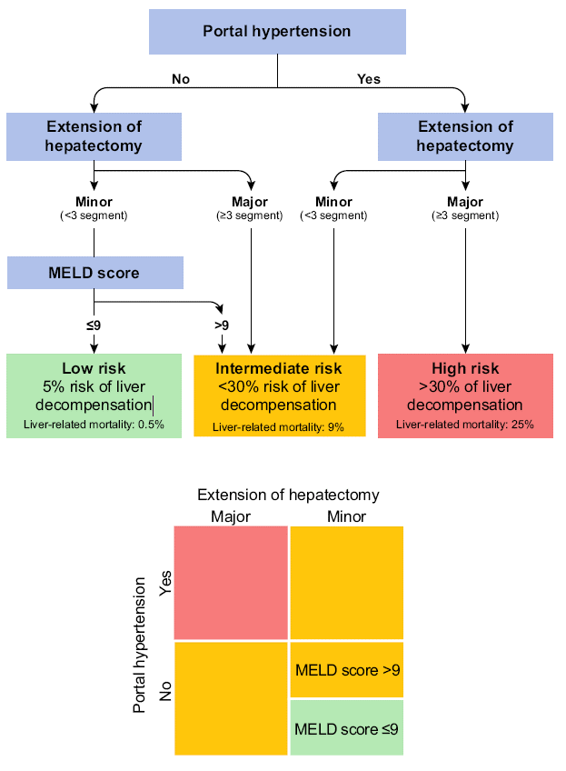
Assessment of post-resection risk of hepatic decompensation
Multi-parametric assessment
Risk of decompensation based on three determinants of liver insufficiency
Portal hypertension
Extent of resection
Liver function
Likelihood of decompensation
High: >30%
Intermediate: <30%
Low: 5%
EASL CPG HCC. J Hepatol 2018; doi: 10.1016/j.jhep.2018.03.019
Notes:
MELD, Model for End-Stage Liver Disease

Slide 32
Assessment of post-resection risk of hepatic decompensation
Multi-parametric assessment
Risk of decompensation based on three determinants of liver insufficiency
Portal hypertension
Extent of resection
Liver function
Likelihood of decompensation
High: >30%
Intermediate: <30%
Low: 5%
EASL CPG HCC. J Hepatol 2018; doi: 10.1016/j.jhep.2018.03.019
Notes:
MELD, Model for End-Stage Liver Disease

Slide 33
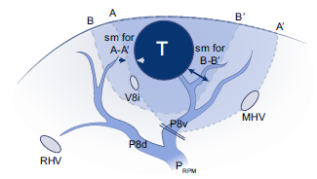
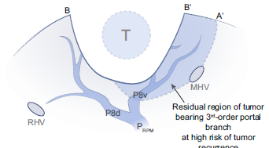
Extent of resection: anatomical vs. non-anatomical^{*1}
A
Anatomical resection (A-A’) removes entirely the tumour-bearing portal branches bordered by the landmark veins, while non-anatomical resection (B-B’) is any other type of resection in which the tumour-bearing 3rd-order portal region is not fully removed
B
After non-anatomical resection of HCC some part of the tumour-bearing portal region is left, which is at high risk of tumour recurrence
Residual region of tumour- bearing 3rd-order portal branch at high risk of tumour recurrence
*Note that studies of newer, less invasive laparoscopic resections have questioned the superiority of anatomic liver resection in HCC of larger size 1. Shindoh J, et al. J Hepatol 2016;65:1062–1063;
EASL CPG HCC. J Hepatol 2018; doi: 10.1016/j.jhep.2018.03.019
Notes:
HCC, hepatocellular carcinoma; MHV, middle hepatic vein; P8v, ventral branch of P8; P8d, dorsal branch of P8; RHV, right hepatic vein; PRPM, right para-median pedicle; V8i, intermediate vein for segment VIII

Slide 34
Liver resection and tumour parameters
Indications and choice of surgical technique depend on tumour size and location(s)
Recommendations
Liver resection is recommended for single HCC of any size In particular, for tumours >2 cm when hepatic function is preserved and sufficient remnant liver volume is maintained | Moderate | Strong
In properly trained centres, liver resection should be considered via laparoscopic/minimally invasive approaches, especially for tumours in anterolateral and superficial locations | Moderate | Weak
HCC presenting with two or three nodules within Milan criteria may be eligible for liver resection depending on: Performance status Co-morbidities Preservation of liver function and remnant volume | Low | Weak
Level of evidence
Grade of recommendation
EASL CPG HCC. J Hepatol 2018; doi: 10.1016/j.jhep.2018.03.019
Notes:
HCC, hepatocellular carcinoma

Slide 35
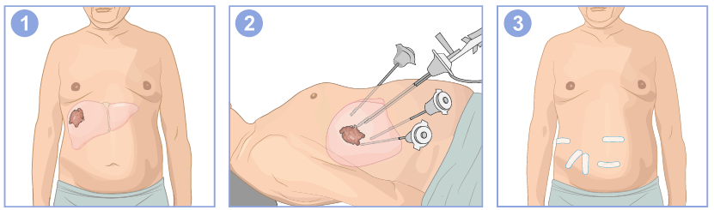
Minimally invasive/laparoscopic resection for HCC
Laparoscopic-robotic resection for HCC located in superficial- peripheral positions of the liver provides optimal survival outcomes
While minimizing complications and hospital stay
Scan detection of liver tumour
Laparoscopic treatment of the affected organ through small openings
Removal of affected region Minimal signs of invasive surgery and rapid patient recovery
EASL CPG HCC. J Hepatol 2018; doi: 10.1016/j.jhep.2018.03.019
Notes:
HCC, hepatocellular carcinoma

Slide 36
Liver resection contraindications and follow-up
A substantial proportion of patients with HCC present with tumour-related portal vein thrombosis
Disease at advanced stage and not amenable to curative treatment
Tumour recurrence complicates 70% of cases at 5 years
Recommendations
HCC-related macrovascular invasion is a contraindication for liver resection Intervention on distal portal invasion – at segmental or sub-segmental level – deserves investigations within prospectively designed protocols | Moderate
Neoadjuvant or adjuvant therapies are not recommended because they have not been proven to improve the outcome of patients treated with resection | High | Strong
Follow-up* after resection with curative intent is recommended because of high rates of treatable recurrence | High | Strong
Level of evidence
Grade of recommendation
*Follow-up intervals are not clearly defined. In the first year, 3–4-month intervals are practical
EASL CPG HCC. J Hepatol 2018; doi: 10.1016/j.jhep.2018.03.019
Notes:
HCC, hepatocellular carcinoma

Slide 37
Treatment of HCC: liver transplantation
Together with NAFLD/NASH, HCC is the fastest growing indication for LT
Milan criteria are the benchmark for selecting patients for LT
Basis for comparison with other suggested criteria
Recommendations
LT is recommended as the first-line option for HCC within Milan criteria but unsuitable for resection | High | Strong
Consensus on expanded criteria for LT in HCC has not been reached Patients outside Milan criteria can be considered for LT after successful downstaging to within Milan criteria, within defined protocols | Moderate | Weak
Composite criteria,* are likely to replace conventional criteria for defining transplant feasibility | Low | Strong
Tumour vascular invasion and extrahepatic metastases are an absolute contraindication for LT in HCC | High
Level of evidence
Grade of recommendation
*That consider surrogates of tumour biology and response to neoadjuvant treatments to bridge or downstage tumours in combination with tumour size and number of nodules: these criteria should be investigated and determined a priori, validated prospectively and auditable at any time
EASL CPG HCC. J Hepatol 2018; doi: 10.1016/j.jhep.2018.03.019
Notes:
HCC, hepatocellular carcinoma; LT, liver transplantation; NAFLD, non-alcoholic fatty liver disease; NASH, non-alcoholic steatohepatitis

Slide 38
Organ allocation and priority for HCC
LT is the therapy with the highest chance of curing HCC
Always consider unless age and co-morbidities advise against LT
Major limiting factor is scarcity of donated organs
Including relative priority with other LT indications
Cirrhosis | HCC + cirrhosis
High pre-transplant mortality | Low pre-transplant mortality
High post-transplant long-term recovery | Variable post-transplant cure, depending on tumour stage at operation
Predictable outcome with no transplant (MELD) | Composite prognostic factors and variable biology influencing outcome
No competitive options besides transplantation | Competitive options in selected patient subgroups
↓ | ↓
Urgency principle | Utility principle
Focused on pre-LT risk of dying | Focused on maximization of post-LT
EASL CPG HCC. J Hepatol 2018; doi: 10.1016/j.jhep.2018.03.019
Notes:
HCC, hepatocellular carcinoma; LT, liver transplantation; MELD, Model for End-Stage Liver Disease

Slide 39
Liver transplant prioritization
Prioritization of cadaveric graft allocation is challenging
Recommendations
The use of marginal cadaveric grafts for LT in patients with HCC has no contraindication | Moderate
Prioritizing a cadaveric graft allocation, for patients with or without HCC, within a common waiting list, is complex: No system can serve all regions Prioritization criteria for HCC should at least include: Tumour burden Tumour biology indicators Waiting time Response to tumour treatment | Moderate | Strong
Transplant benefit may need to be considered alongside the conventional transplant principles of urgency and utility in decision making, depending on list composition and dynamics | Moderate | Weak
Level of evidence
Grade of recommendation
EASL CPG HCC. J Hepatol 2018; doi: 10.1016/j.jhep.2018.03.019
Notes:
HCC, hepatocellular carcinoma; LT, liver transplantation

Slide 40
Allocation models considered in LT
Model | Definition
Urgency | Focused on pre-transplant risk of dying: patients with worse outcome on the waiting list are given higher priority for transplantation (based on Child–Pugh or MELD score)
Utility | Based on maximization of post-transplant outcome, takes into account donor and recipient characteristics: mainly used for HCC since the MELD score poorly predicts post-transplant outcome in HCC due to the absence of donor factors and lack of predicting tumour progression while waiting
Benefit | Calculated by subtracting the survival achieved with LT by the survival obtained without LT. Ranks patients according to the net survival benefit that they would derive from transplantation and maximizes the lifetime gained through transplantation. If applied to HCC without adjustments, it may prioritize patients at highest risk of recurrence
Dotted lines represent different levels of survival achieved with non-transplant options
Bruix J et al. Gut 2014;63:844–55;
EASL CPG HCC. J Hepatol 2018; doi: 10.1016/j.jhep.2018.03.019
Notes:
HCC, hepatocellular carcinoma; LT, liver transplantation; MELD, Model for End-Stage Liver Disease

Slide 41
Pre-LT therapy and living donor options
LT candidates with HCC waiting for a cadaveric donor can maintain eligibility with bridging therapy
Living donor LT may be an option in certain circumstances
Recommendations
In LT candidates with HCC, pre-transplant (neoadjuvant) loco-regional therapies are recommended if feasible Reduces the risk of pre-LT drop-out Lowers post-LT recurrence – particularly if CR or PR is achieved | Low | Strong
Contribution of living donation to LT for HCC in Europe is still marginal Living donor LT for HCC remains an option to be explored in selected patients and in experienced centres: According to waiting list time and dynamics Within donor-recipient double equipoise principles | Low
Level of evidence
Grade of recommendation
EASL CPG HCC. J Hepatol 2018; doi: 10.1016/j.jhep.2018.03.019
Notes:
CR, complete response; HCC, hepatocellular carcinoma; LT, liver transplantation; PR, partial response

Slide 42
Local ablation and external radiation
Tumour ablation techniques have improved along with the imaging-guidance tools required to ensure their successful application
Recommendations
Thermal ablation with radiofrequency is the standard of care for patients with BCLC-0 and A tumours not suitable for surgery* | High | Strong
In patients with very early stage HCC (BCLC-0) radiofrequency ablation in favourable locations can be adopted as first-line therapy even in surgical patients | Moderate | Strong
Microwave ablation showed promising results for local control and survival | Low
Ethanol injection is an option in some cases where thermal ablation is not technically feasible, especially in tumours <2 cm | High | Strong
External beam radiotherapy is under investigation So far there is no robust evidence to support this therapeutic approach in the management of HCC | Low | Weak
Level of evidence
Grade of recommendation
*Thermal ablation in single tumours 2–3 cm in size is an alternative to surgical resection based on technical factors (location of the tumour), hepatic and extrahepatic patient conditions
EASL CPG HCC. J Hepatol 2018; doi: 10.1016/j.jhep.2018.03.019
Notes:
BCLC, Barcelona Clinic Liver Cancer; HCC, hepatocellular carcinoma

Slide 43
Percutaneous ablation
Radiofrequency ablation
Microwave ablation
Cryoablation
Irreversible electroporation
Monopolar RFA
Active energy deposition: few mm
Active energy deposition: ~1 cm
Ice ball: ~1–3 cm
Multibipolar No touch RFA
Heat diffusion
Heat diffusion
Cold diffusion
Cell membrane
Advantages
Limitations
Well-evaluated treatment (reference)
Multibipolar mode: increases volume and predictability (margin) of ablation zone
Higher and faster temperature picks reached than with RFA (less sensitive to heat sink effect than monopolar RFA)
Easy monitoring with imaging of ice ball progression
Limited risk of thermal injury to neighbouring critical structures
Unsensitive to heat sink effect
Advantage of multibipolar mode (no touch technique, predictability of margins)
Thermal injury of adjacent structure
Heat sink effect (near major vessels)
Multibipolar mode is less sensitive to heat sink effect
No reliable endpoint to set the amount of energy deposition
Cryoshock with first device
Limited clinical data available with new devices
Only preliminary clinical data
General anaesthesia using curare and major analgesic drugs is mandatory
Nault J-C, et al. J Hepatol 2018;68:783–97
EASL CPG HCC. J Hepatol 2018; doi: 10.1016/j.jhep.2018.03.019
Notes:
HCC, hepatocellular carcinoma; RFA, radiofrequency ablation.

Slide 44
Transarterial therapies
Benefits of TACE in appropriately selected patients have been robustly demonstrated
Recommendations
TACE is recommended for patients with BCLC stage B and should be carried out in a selective manner | High | Strong
The use of drug-eluting beads has shown similar benefit to conventional TACE and either of the two can be utilized | High | Strong
TACE should not be used in patients with: Decompensated liver disease Advanced liver and/or kidney dysfunction Macroscopic vascular invasion Extrahepatic spread | High | Strong
Level of evidence
Grade of recommendation
EASL CPG HCC. J Hepatol 2018; doi: 10.1016/j.jhep.2018.03.019
Notes:
BCLC, Barcelona Clinic Liver Cancer; TACE, transarterial chemoembolization

Slide 45
Transarterial therapies in development
Potential benefits of other transarterial therapies have yet to be sufficiently demonstrated
Level of evidence
Recommendations
There is insufficient evidence to recommend bland embolization, selective intra-arterial chemotherapy and lipiodolization | Moderate
TARE/SIRT using yttrium-90 microspheres has been investigated in: Patients with BCLC-A for bridging to transplantation Patients with BCLC-B to compare with TACE Patients with BCLC-C to compare with sorafenib Current data: Show good safety profile and local tumour control Fail to show overall survival benefit compared to sorafenib in BCLC-B and -C patients The subgroup of patients benefitting from TARE needs to be defined | Moderate
There is insufficient evidence to recommend scores that better select BCLC-B candidates for first TACE or for subsequent sessions | Moderate
EASL CPG HCC. J Hepatol 2018; doi: 10.1016/j.jhep.2018.03.019
Notes:
BCLC, Barcelona Clinic Liver Cancer; SIRT, selective internal radiation therapy; TACE, transarterial chemoembolization; TARE, transarterial radioembolization

Slide 46
First-line systemic therapies
VEGFR and multi-kinase inhibitors have shown survival benefits in advanced HCC
First line: sorafenib and lenvatinib
Recommendations
Sorafenib is the standard first-line systemic therapy for HCC, indicated for patients with: Well-preserved liver function (Child–Pugh A) and with advanced tumours (BCLC-C) Earlier stage tumours progressing upon, or unsuitable for, loco-regional therapies | High | Strong
Lenvatinib is non-inferior to sorafenib and is also recommended in first-line therapy for patients with: Well-preserved liver function, good performance status and advanced tumours (BCLC-C) without main portal vein invasion Tumours progressing with, or unsuitable for, loco-regional therapies | High | Strong
There are no clinical or molecular biomarkers established to predict response to first- or second-line systemic treatments | Moderate
Level of evidence
Grade of recommendation
EASL CPG HCC. J Hepatol 2018; doi: 10.1016/j.jhep.2018.03.019
Notes:
BCLC, Barcelona Clinic Liver Cancer; HCC, hepatocellular carcinoma; VEGFR, vascular endothelial growth factor receptor

Slide 47
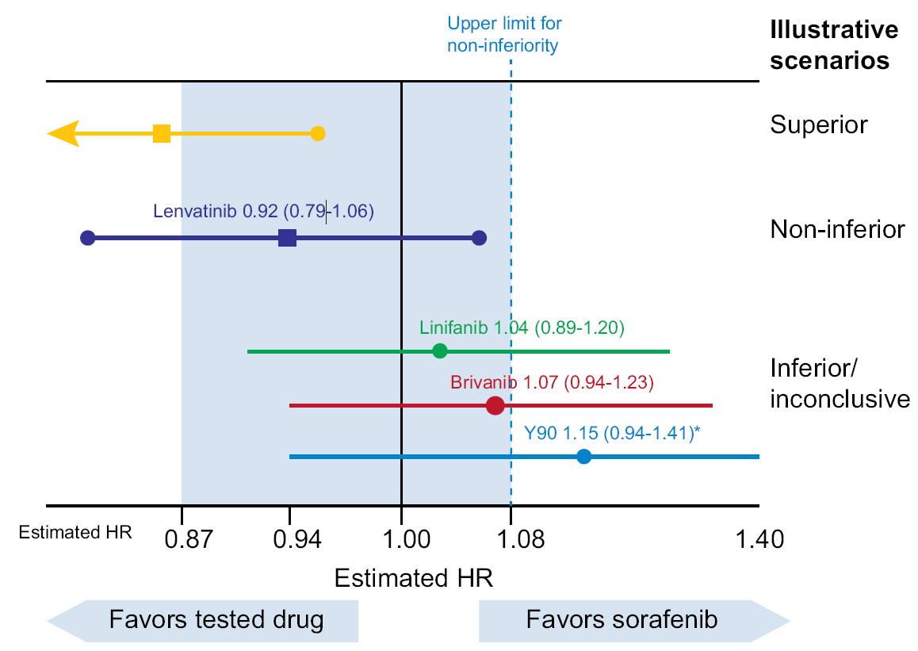
Non-inferiority results in advanced HCC
RCTs in advanced HCC
Comparison of first-line drugs/devices vs. sorafenib
Favours tested drug
Favours sorafenib
EASL CPG HCC. J Hepatol 2018; doi: 10.1016/j.jhep.2018.03.019
Notes:
HCC, hepatocellular carcinoma; RCT, randomized controlled trial

Slide 48
Second-line systemic therapies
VEGFR and multi-kinase inhibitors have shown survival benefits in advanced HCC
First line: sorafenib and lenvatinib
Second line: regorafenib (and cabozantinib and ramucirumab*)
Another agent that has shown some promise is the checkpoint inhibitor nivolumab
Level of evidence
Grade of recommendation
Recommendations
Regorafenib is recommended as second-line treatment for patients: Tolerating and progressing on sorafenib With well-preserved liver function (Child–Pugh class A) With good performance status | High | Strong
Cabozantinib and ramucirumab* have shown survival benefits vs. placebo in this setting | - | -
Based on uncontrolled but promising data, immune therapy with nivolumab has received FDA approval in second-line treatment, pending Phase 3 data for conventional approval At present, the data are not mature enough to give a clear recommendation | Moderate | Weak
*In patients with high baseline alpha-fetoprotein (> 400 ng/ml)
EASL CPG HCC. J Hepatol 2018; doi: 10.1016/j.jhep.2018.03.019
Notes:
HCC, hepatocellular carcinoma; VEGFR, vascular endothelial growth factor receptor

Slide 49
Systemic therapies in development
Other systemic treatments are in development
Have not yet demonstrated non-inferiority or clinical benefit
Further clinical trials are required
Recommendations
Treatments that failed to meet their endpoints in randomized trials are not recommended Further clinical trials are needed to confirm claims of non-inferiority, or any trends of better outcome identified in subgroup analysis | High
Patients at BCLC D stage, who are not LT candidates, should receive palliative support, including management of pain, nutrition and psychological support In general, they should not be considered for clinical trials | Low | Strong
Level of evidence
Grade of recommendation
EASL CPG HCC. J Hepatol 2018; doi: 10.1016/j.jhep.2018.03.019
Notes:
BCLC, Barcelona Clinic Liver Cancer; LT, liver transplantation

Slide 50
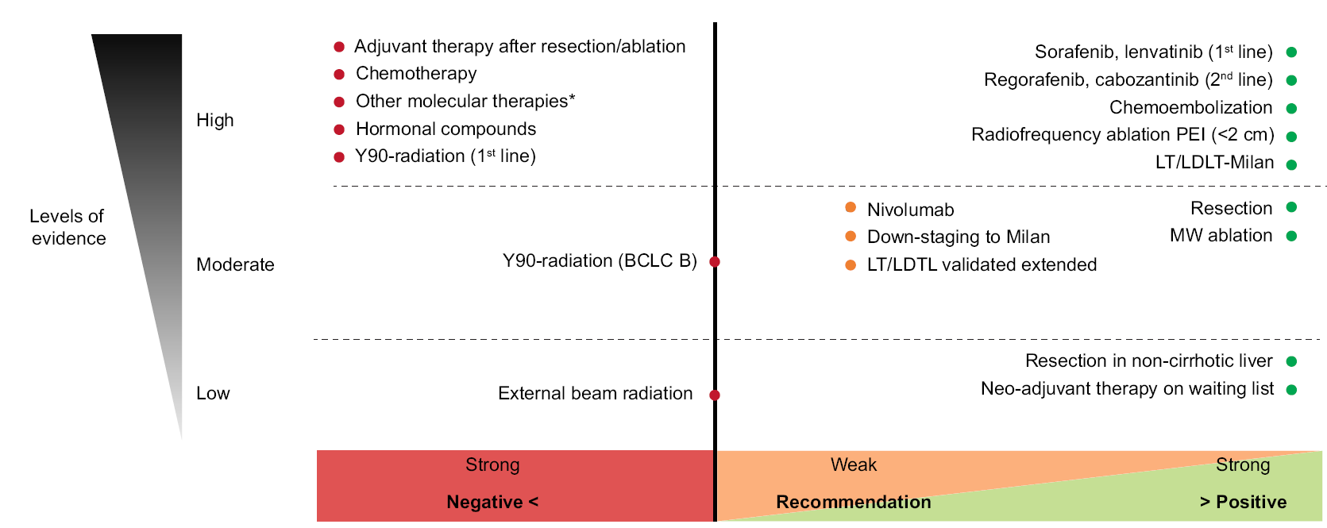
Overview of EASL recommendations for treatment
*Other molecular therapies: sunitinib, linifanib, brivanib, tivantinig, erlotinib, everolimus
Weak recommendation: more evidence needed
EASL CPG HCC. J Hepatol 2018; doi: 10.1016/j.jhep.2018.03.019
Notes:
BCLC, Barcelona Clinic Liver Cancer; LDLT, living donor liver transplantation; LT, liver transplantation; MW, microwave; PEI, percutaneous ethanol injection;

Slide 51
Assessment of response to treatment
Different methods of response assessment are appropriate for different treatments
Recommendations
Assessment of response in HCC should be based on mRECIST for loco-regional therapies | Moderate | Strong
For systemic therapies both mRECIST and RECIST1.1 are recommended | Moderate | Weak
Multiphasic contrast-enhanced CT or MRI are recommended for assessment of response after resection, loco-regional or systemic therapies | Moderate | Weak
Level of evidence
Grade of recommendation
EASL CPG HCC. J Hepatol 2018; doi: 10.1016/j.jhep.2018.03.019
Notes:
CT, computed tomography; HCC, hepatocellular carcinoma; mRECIST, modified Response Evaluation Criteria in Solid Tumors; MRI, magnetic resonance imaging; RECIST, Response Evaluation Criteria in Solid Tumors

Slide 52
Palliative and best supportive care
Management of end-stage disease is only symptomatic
No tumour-directed treatment is indicated
Recommendations
In HCC on cirrhosis: Acetaminophen ≤3 g/day to manage pain of mild intensity NSAIDs should be avoided whenever possible in patients with underlying cirrhosis. Opioids to manage pain of intermediate or severe intensity (proactively avoid constipation) | Low | Weak
Bone metastases causing pain, or at significant risk of spontaneous secondary fracture, benefit from palliative radiotherapy | Low
Level of evidence
Grade of recommendation
EASL CPG HCC. J Hepatol 2018; doi: 10.1016/j.jhep.2018.03.019
Notes:
HCC, hepatocellular carcinoma; NSAID, non-steroidal anti-inflammatory drug

Slide 53
Psychological care in the palliative setting
Psychological burden of end-stage HCC should not be neglected or underestimated
Recommendations
In patients with advanced cirrhosis, use of psychoactive drugs (particularly benzodiazepines) to treat psychological distress is associated with an increased risk of falls, injuries, and altered mental status Therefore, great caution should be adopted when using them in patients with HCC and cirrhotic liver dysfunction | Low | Strong
Psycho-oncological support and adequate nutrition is recommended according to patients’ condition | Low | Strong
Level of evidence
Grade of recommendation
EASL CPG HCC. J Hepatol 2018; doi: 10.1016/j.jhep.2018.03.019
Notes:
HCC, hepatocellular carcinoma

Slide 54
HCC research and future goals
Trial design and endpoints
EASL future goals in HCC
Unmet needs in HCC
Notes:
HCC, hepatocellular carcinoma

Slide 55
Trial design and endpoints
Clinical trial endpoints should be chosen with care
OS is the most important endpoint in oncology and HCC research, and is not subject to investigator bias
Recommendations
Primary endpoint for Phase 3 clinical trials should be: OS, when testing primary treatments Recurrence-free survival or time to response, when testing adjuvant therapies after resection/ablation | Strong
Endpoints for testing neoadjuvant treatments in patients on the LT waiting list should be: OS Cancer-related deaths Waiting list drop-out rate | Strong
No optimal surrogate endpoints able to recapitulate OS in HCC exist TTP and PFS are not suggested as primary endpoints | High | Weak
Level of evidence
Grade of recommendation
EASL CPG HCC. J Hepatol 2018; doi: 10.1016/j.jhep.2018.03.019
Notes:
HCC, hepatocellular carcinoma; LT, liver transplantation; OS, overall survival: PFS, progression-free survival; TTP, time to progression

Slide 56
Response criteria in clinical trials
Validity of response criteria can vary depending on the treatment type studied
Recommendations
ORR, in particular complete response by mRECIST, correlates with OS in patients treated with thermal ablation and TACE* | High
For Phase 2 trials testing TACE or thermal ablation, ORR and complete response, respectively, may be considered as primary endpoints | Weak
Phase 2 studies testing systemic therapies should be randomized and should target OS as a primary endpoint† | Strong
Use of RECIST 1.1. and mRECIST is suggested for the assessment of response in HCC treated with systemic therapy | Weak
Level of evidence
Grade of recommendation
*Conversely, ORR and disease control rate have not been robustly shown to correlate with OS in patients receiving systemic therapies; †ORR, TTP and recurrence-free survival can be assessed as secondary endpoints
EASL CPG HCC. J Hepatol 2018; doi: 10.1016/j.jhep.2018.03.019
Notes:
HCC, hepatocellular carcinoma; mRECIST, modified Response Evaluation Criteria in Solid Tumors; ORR, objective response rate; OS, overall survival; RECIST, Response Evaluation Criteria in Solid Tumors; TACE, transarterial chemoembolization; TTP, time to progression

Slide 57
Patient selection in clinical trials
Careful attention to patient selection is crucial
Recommendations
Selection of the target population for clinical trials should use: BCLC staging system Child–Pugh class ECOG performance status | Strong
Stratification for prognostic factors prior to randomization is critical in randomized studies and is recommended | High | Strong
The control arm of randomized Phase 2 and 3 studies should be the standard of care established in the current guidelines When no standard of care (adjuvant trials, third-line setting) a placebo-control arm is recommended | Strong
Upfront liver biopsy and blood sampling is recommended for clinical and diagnostic trials | Strong
Level of evidence
Grade of recommendation
EASL CPG HCC. J Hepatol 2018; doi: 10.1016/j.jhep.2018.03.019
Notes:
BCLC, Barcelona Clinic Liver Cancer; ECOG, Eastern Cooperative Oncology Group

Slide 58
EASL future goals in HCC
The EASL HCC panel suggested focusing on the following three goals:
Public health policies to prevent, detect, and treat chronic liver disease
Appropriate cancer surveillance to detect HCC in a stage amenable to curative treatment
Link molecular subclasses in clinical trials to therapeutic response and outcome
EASL CPG HCC. J Hepatol 2018; doi: 10.1016/j.jhep.2018.03.019
Notes:
HCC, hepatocellular carcinoma

Slide 59
Unmet needs to achieve EASL future goals
Major health policy interventions to secure:
Universal vaccination against HBV
Universal treatment of HCV if indicated
Prevention of heavy alcohol intake and obesity
Universal implementation of surveillance programmes
New tools for early detection, including assessment of liquid biopsy
Transition to biopsy for HCC in all instances once a tissue biomarker predicting response is available
Development of new therapies for improving outcome, including adjuvant therapies, combination trials with checkpoint inhibitors and other drugs, and modalities (TKIs, loco-regional therapies, radiation)
Development of third-line therapies in advanced stage
Define optimal sequencing of systemic therapy
EASL CPG HCC. J Hepatol 2018; doi: 10.1016/j.jhep.2018.03.019
Notes:
HBV, hepatitis B virus; HCV, hepatitis C virus; HCC, hepatocellular carcinoma; TKI, tyrosine-kinase inhibitor

Slide 60
Unmet needs to achieve EASL future goals
Surrogate markers recapitulating OS
Translate molecular knowledge into precision medicine, linking response rates in trials to molecular subgroups
Assess the role of prognostic and predictive markers in surgical and interventional therapies within prospective investigations
Understand the impact of minimal invasive surgery on HCC recurrence and post-progression survival
Define and evaluate reliable quality of life assessment tools in HCC
Stratify patients at risk for hepatocellular carcinoma and the utilization of chemopreventive strategies
EASL CPG HCC. J Hepatol 2018; doi: 10.1016/j.jhep.2018.03.019
Notes:
HCC, hepatocellular carcinoma; OS, overall survival

